Slide 1
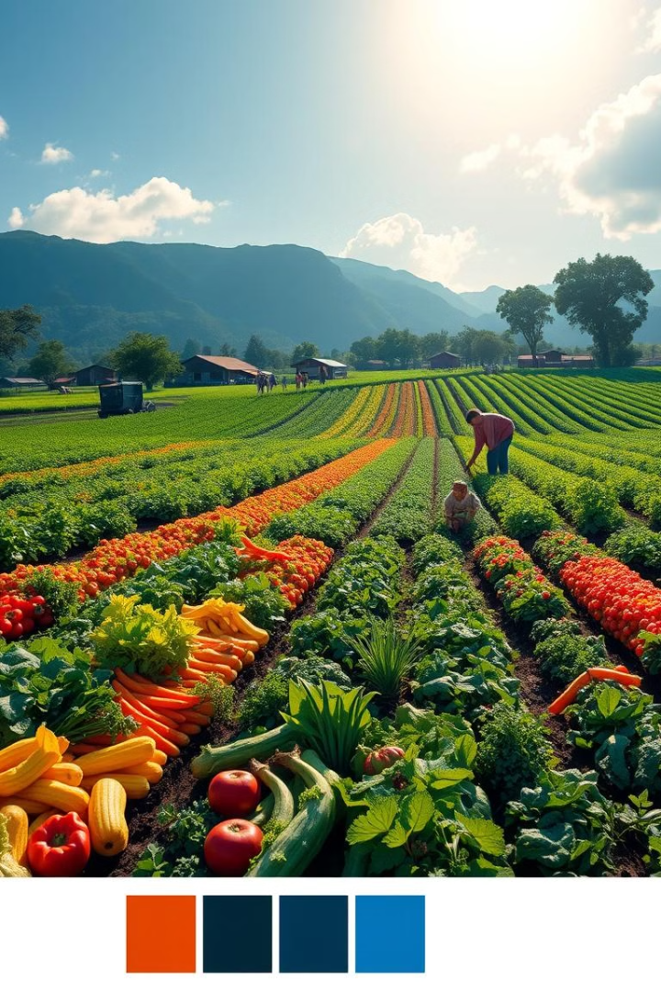
Sustainable Agriculture: Feeding the Future
Presented by :
Soumya Bharatha
2203A52007
Guided by :
Dr P Chandra Shekhar Reddy
Professor of CSE

Slide 2
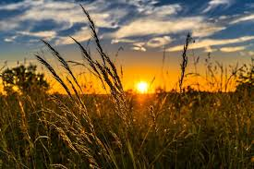
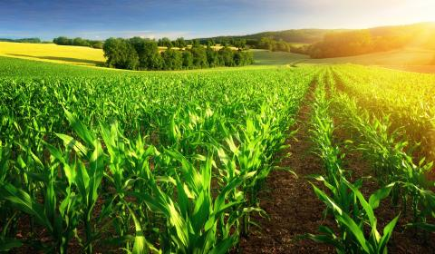
Sustainable agriculture is a farming system that aims to be environmentally, economically, and socially sustainable. It uses science-based practices to produce food and fibre while minimising environmental damage. Sustainable agriculture is farming in such a way to protect the environment, aid and expand natural resources and make the best use of nonrenewable resources.

Slide 3
The Challenges of Conventional Agriculture
Depletion of Natural Resources
Environmental Degradation
Intensive farming practices lead to soil degradation, water depletion, and biodiversity loss. This weakens ecosystems and reduces their ability to support life.
Excessive use of fertilizers and pesticides contaminates soil and water sources, harming wildlife and human health. These practices also contribute to climate change.

Slide 4
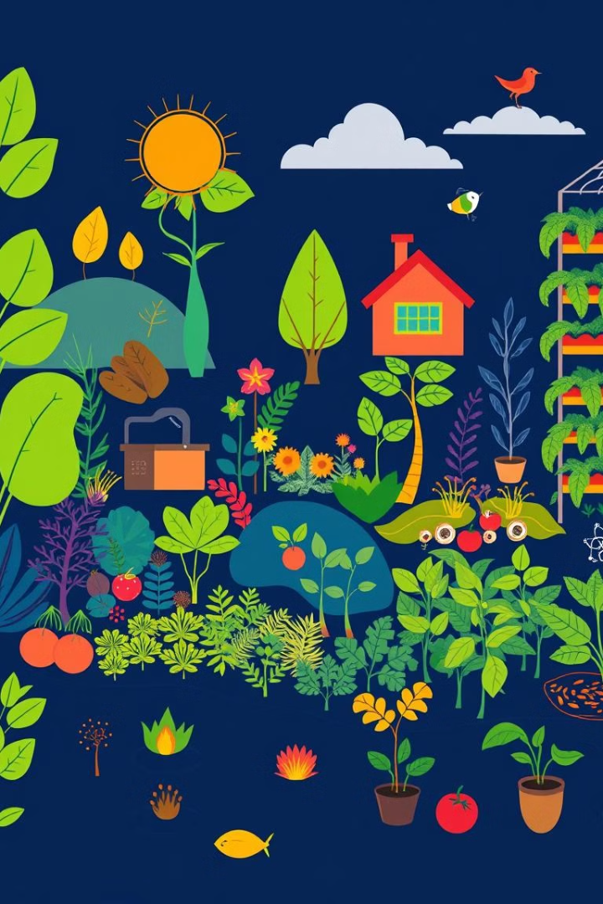
Understanding Sustainable Farming Practices
1
Conserving Resources
2
Protecting Biodiversity
Sustainable agriculture focuses on minimizing resource use and maximizing efficiency. This involves using water wisely, reducing fertilizer and pesticide applications, and promoting natural pest control.
Sustainable practices promote biodiversity by creating habitats for wildlife and preserving natural ecosystems. This helps maintain a healthy and resilient environment for all species.

Slide 5
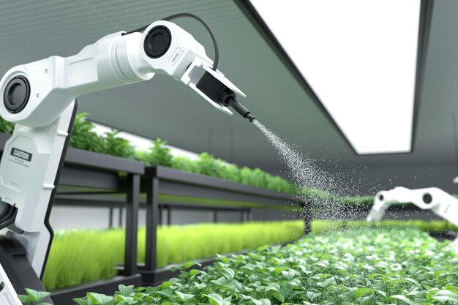
Role of Technology in Sustainable Agriculture
Precision Farming
Tech Involved: GPS, IoT, sensors, and satellite imagery.
Benefits: Reduces water and fertilizer usage by targeting specific areas.
Example: Farmers use moisture sensors to water crops only when needed, reducing waste and conserving resources.
Drones and Remote Sensing
Applications: Mapping fields, identifying stressed plants, and assessing crop health.
Real-World Use: Drones with infrared cameras can spot nutrient deficiencies invisible to the naked eye.
Big Data and Cloud Computing
Functions: Collects and processes vast amounts of data, including weather forecasts, pest outbreaks, and yield predictions.
Impact: Allows farmers to make informed decisions and adapt to climate change challenges.

Slide 6
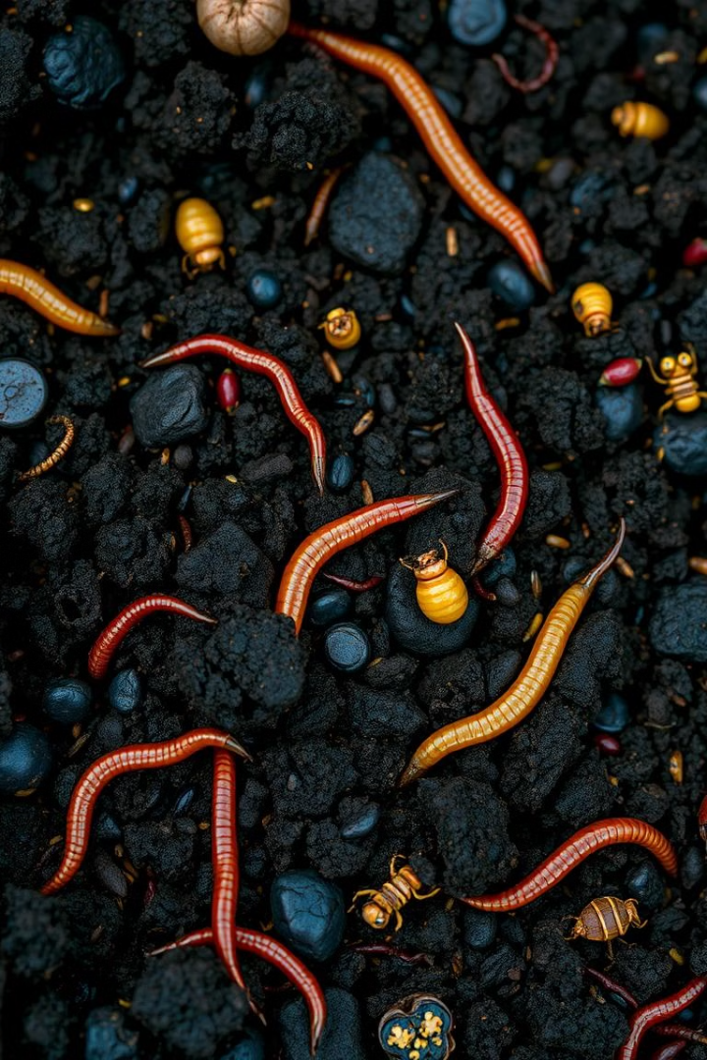
Soil Health and Nutrient Management
Organic Matter
Crop Rotation
Adding organic matter like compost and manure improves soil structure, fertility, and water retention. This supports healthy plant growth and reduces the need for synthetic fertilizers.
Rotating crops helps break disease cycles, prevent pest infestations, and improve soil health. It allows different plants to extract nutrients from the soil in a balanced way.
Cover Cropping
Planting cover crops between main crops helps prevent soil erosion, suppress weeds, and improve soil fertility. They also provide food and shelter for beneficial insects.

Slide 7
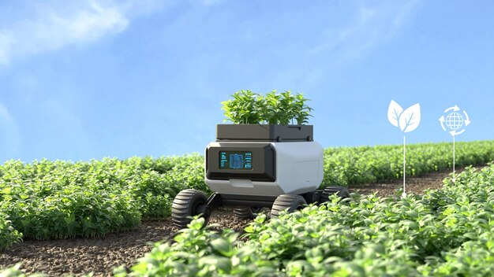
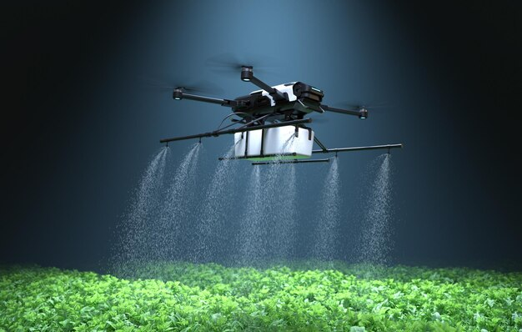
Advanced Technologies Empowering Sustainability
AI and Machine Learning
Uses: Forecasting crop yields, optimising planting schedules, and detecting pest infestations.
Example: AI models predict disease outbreaks, helping to apply targeted biological treatments.
Robotics and Automation
Functions: Autonomous machinery for seeding, harvesting, and weed removal.
Impact: Reduces dependency on manual labour and ensures timely field operations.
Renewable Energy Integration
Examples:
Solar-Powered Irrigation Systems: Ensure efficient water use.
Wind Turbines: Generate electricity for farm operations.
Result: Decreases carbon footprint and promotes energy independence.

Slide 8
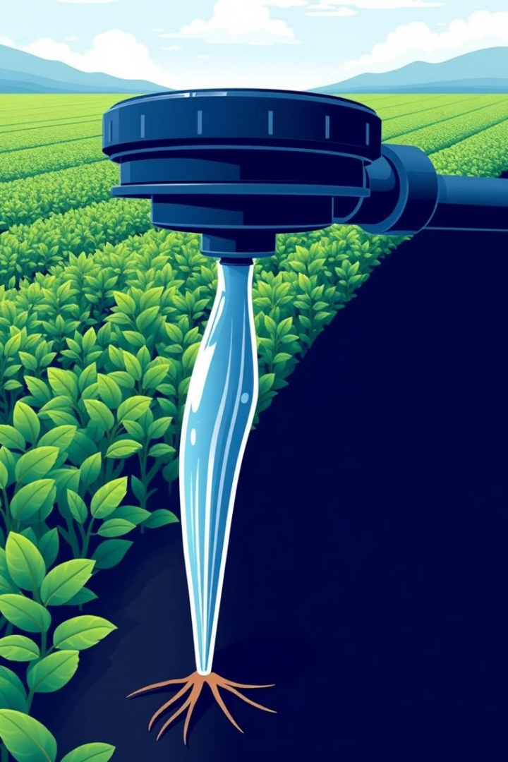


Efficient Water Usage and Conservation
Drip Irrigation
Water Harvesting
Delivers water directly to plant roots, minimizing waste and maximizing efficiency. It also reduces the risk of waterborne diseases.
Collecting rainwater and storing it for later use reduces reliance on external sources and helps conserve water resources. This practice is particularly important in dry regions.

Slide 9
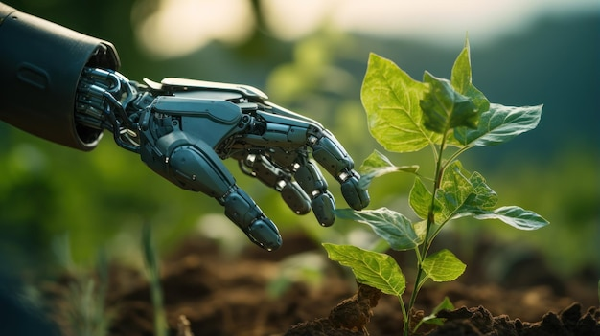
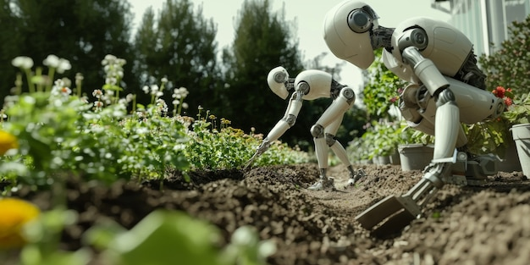
Emerging Trends in Agri-Tech
Blockchain for Transparent Supply Chains
Tracks the journey of food from farm to consumer, ensuring fair trade and sustainability.
Reduces food fraud and increases consumer trust.
Vertical and Urban Farming
Utilizes LED lighting, automated nutrient delivery, and climate control in indoor farms.
Maximizes yield in urban spaces while using 90% less water than traditional farming.
Biotechnology
Develop drought-resistant and pest-tolerant crops through genetic engineering.
Promotes sustainability by reducing reliance on chemical pesticides and fertilisers.

Slide 10
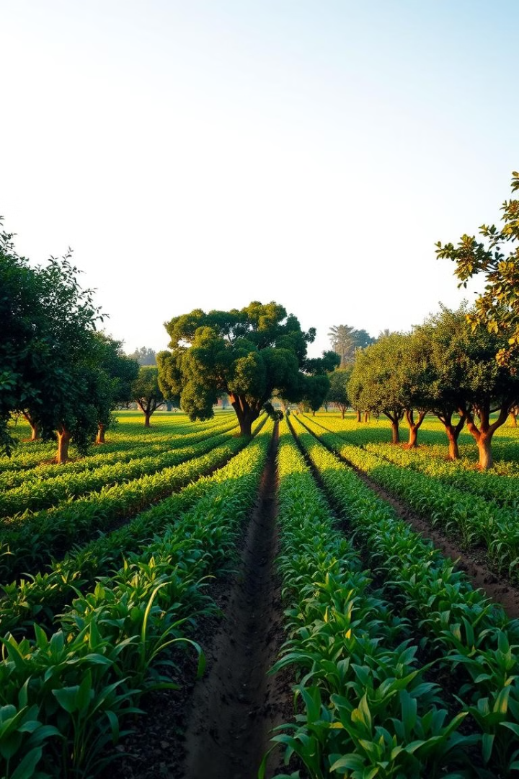
Biodiversity and Ecosystem Protection
1
Pollinator Protection
Sustainable practices promote the well-being of pollinators, ensuring their vital role in crop fertilization. This involves creating pollinator-friendly habitats and reducing pesticide use.
2
Habitat Creation
Creating natural habitats for wildlife on farms provides refuge for beneficial insects, birds, and other animals that help control pests and maintain ecosystem balance.
3
Soil Conservation
Implementing soil conservation methods such as no-till farming and contour farming helps prevent erosion and protect the soil's natural structure and fertility.

Slide 11




Sustainable Supply Chains and Distribution
Local Sourcing
Supporting local farms and businesses reduces transportation distances, minimizes emissions, and promotes regional economies. This fosters community engagement and creates a more sustainable food system.
Fair Trade Practices
Ensuring fair wages and working conditions for farmers and workers throughout the supply chain promotes ethical production and supports sustainable development.
Reducing Food Waste
Implementing strategies to minimize food waste at every stage of the supply chain, from production to consumption, reduces resource use and promotes responsible food practices.

Slide 12



The Economic and Environmental Benefits of Sustainable Agriculture
Increased Profitability
1
Sustainable practices often lead to higher yields, lower input costs, and premium prices for sustainably produced products.
Reduced Pollution
2
Minimizing pesticide and fertilizer use reduces pollution of water sources, air, and soil, leading to a healthier environment for all.
Enhanced Biodiversity
3
Creating habitats for wildlife and preserving natural ecosystems promotes biodiversity, ensuring a rich and resilient environment for all species.

Slide 13
CONCLUSION
Transforming Food Systems
1
Sustainable agriculture plays a critical role in transforming our food systems to be more equitable, environmentally responsible, and resilient.
A Sustainable Future
2
By embracing sustainable practices, we can create a future where agriculture nourishes our planet and sustains future generations.

Slide 14

THANK YOU

